Slide 1
TEOA Portal Slides
4-2017

Slide 2
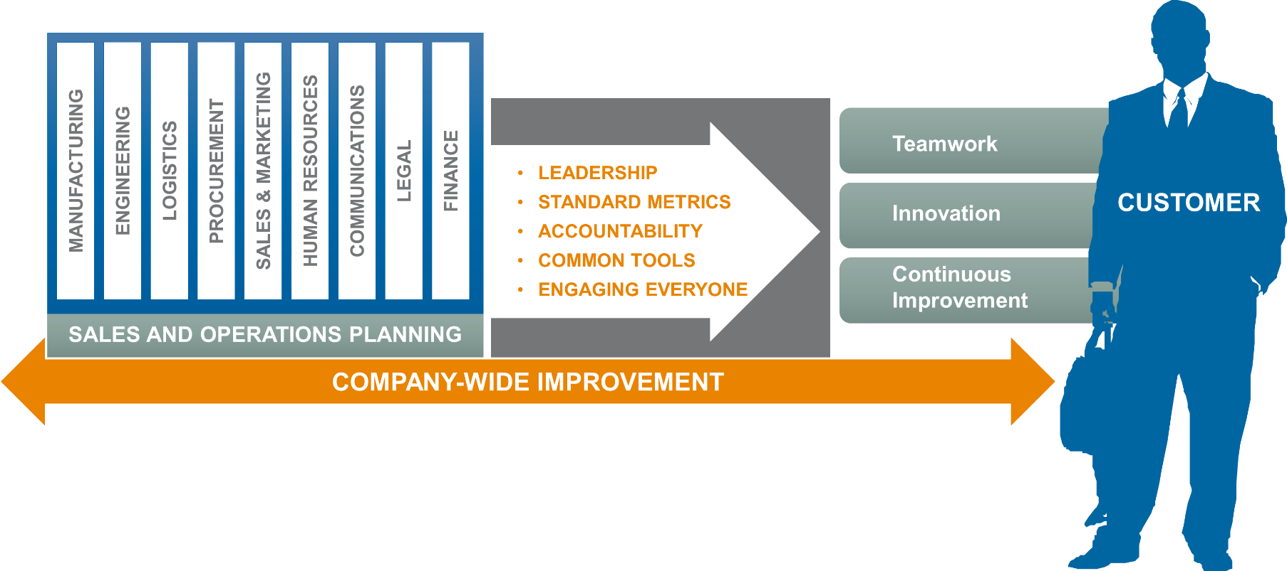
TEOA Vision
TEOA is our company-wide business system used to drive transformational change across our business.
TEOA is the DNA of our company,
driving the extraordinary customer experience
Deploying TEOA Everywhere will Transform TE into a Lean Enterprise
Notes:
Success at TE doesn’t happen by accident. We have a proven system for achieving it. We call it TEOA.
It is our Business System that drives every aspect of our culture and performance. It is the ‘DNA’ or our company. Creating more value for our customers, delivering an extraordinary customer experience is the driving force behind the TEOA.
Achieving the full benefits of TEOA requires total implementation across all operations and functions, TEOA Everywhere
It is the role of every leader to lead TEOA and to inspire with words, deeds and actions. Leaders are expected to lead the change, be innovative, challenge the status quo and empower people to implement necessary changes in a spirit of thrust and recognition.
Getting everyone involved with TEOA will not only leverage our efforts, but will, eventually, lead to a company culture of continuous improvement
TEOA is our guide what we do and how we do, using a common set of tools to help us improving our processes, and a standard set of metrics to measure how well we execute.
By implementing TEOA everywhere and transforming TE to a lean enterprise, we can reduce cost, increase quality, reduce our lead time to give us a competitive advantage, give our customers an extraordinary customer experience, and help our employees become more engaged and satisfied with their jobs.
Ask the group. Why are we doing TEOA? Answer: to drive extraordinary customer satisfaction to enable growth for our company.

Slide 3
Why TEOA in Procurement
Quality
Delivery
Price
Service
Drive Quality Improvements
Drive quality plans with your plants and suppliers that:
Prevent field escapes
Meet annual PPM improvement goals
Meet annual warranty & reliability improvement goals
Prevent disruptions in TE factories / warehouses
Develop & Execute Optimal Supply Chain
Implement best in class lead times to improve TE customer delivery performance
Implement vendor managed inventory if requested
Drive delivery plans that improve on-time delivery
Develop optimal supply chain to TE (drive localization to best cost option within region)
Help optimize packaging
Achieve Best Total Global Landed Cost
Agree to multi-year productivity commitments
Improve VA/VE execution
Provide cost transparency
Proactively manage raw material volatility, index (+/-) as requested
Agree to standard TE terms and conditions
Deliver product compliance
Meet TE Supplier Social Responsibility
Track diversity spend
Provide Strong Support for TE Stakeholders
Be proactive to needs of TE customers & stakeholders
Assure timely deliverables during development cycle
Bring best product and process technology to TE
Innovate to differentiate
Escalate concerns early and resolve issues quickly
Driving results through actions consistent with TE employee code of conduct and supplier social responsibility
Notes:
Supplier Expectations- Always take opportunity to talk about four pillars
Tell a supplier if they are doing a good job if they are meeting our expectations.
Always talk to suppliers about all four areas.
Be familiar with what we are looking for.
Great time to make sure they are signing up to our SSR and compliance.
Social responsibility – our customers are demanding more from us
Make sure familiar with the bullets and using them
When meeting with suppliers, make sure you take the time to talk about all 4 priorities, even if they’re doing a great jon in one – say “great job!”
Need multi-year agreements with productivity built in
Transparency on cost
Involvement in VA / VE

Slide 4
Delight our Customers:
Increase the amount and improve the quality of value added activity to the Business
Operations
Engineering
Quality
Procurement
Stronger
Partnerships
Logistics
Sales & Planning
Extraordinary Customer Experience
Notes:
Following the TEOA-F presentation

